Slide 1
Quiz on Lecture 13
Please receive the quiz handout from Cyrille, Oliver, Vincent, Jan
Complete the quiz in silence
Hand the quiz back

Slide 2
Quiz on Lecture 13
Why is it better to use the term “agentic AI” rather than “AI agents”?
Because it sounds cooler
Because the field is not yet fully developed and there is no clear definition of what an AI agent is, but “agentic” suggests it is a continuum, where the systems can be more or less agentic, rather than a binary decision whether it is an agent or not.
Because "agentic AI" doesn't require technical expertise to understand
Because "agentic AI" guarantees better performance
Why is it recommended to use LangChain for implementing agentic AI, rather than implementing it from scratch?
Because LangChain is the only option available for implementing agentic AI
Because using LangChain immediately makes you an expert in AI
Because it abstracts away the unnecessary details and helps you focus on the big picture, rather than implementation details.
Because LangChain automatically uses structured output with LLMs, so it guarantees that the AI will never fail
Which of the following is not a part of the LangChain ecosystem:
LangChain
LangAgent
LangGraph
LangSmith
Which of the following is not one of the four agentic AI patterns?
Reflection
Tool use
Structured output
Planning
Multi-agent collaboration
What does ReAct in ReAct agents stand for?
Research + Activate
Reason + Act
Relax + Act
Read + Activate

Slide 3
Quiz on Lecture 13
Why is it better to use the term “agentic AI” rather than “AI agents”?
Because it sounds cooler
Because the field is not yet fully developed and there is no clear definition of what an AI agent is, but “agentic” suggests it is a continuum, where the systems can be more or less agentic, rather than a binary decision whether it is an agent or not.
Because "agentic AI" doesn't require technical expertise to understand
Because "agentic AI" guarantees better performance
Why is it recommended to use LangChain for implementing agentic AI, rather than implementing it from scratch?
Because LangChain is the only option available for implementing agentic AI
Because using LangChain immediately makes you an expert in AI
Because it abstracts away the unnecessary details and helps you focus on the big picture, rather than implementation details.
Because LangChain automatically uses structured output with LLMs, so it guarantees that the AI will never fail
Which of the following is not a part of the LangChain ecosystem:
LangChain
LangAgent
LangGraph
LangSmith
Which of the following is not one of the four agentic AI patterns?
Reflection
Tool use
Structured output
Planning
Multi-agent collaboration
What does ReAct in ReAct agents stand for?
Research + Activate
Reason + Act
Relax + Act
Read + Activate

Slide 4
Designing and Deploying
end-to-end
Production Grade ML Applications
Lecture 12: AI Agents
October 2025
Jan Ravnik & Oliver Angélil

Slide 5
Contents of three AI Agents Lectures:
Lecture 12: Fundamentals of LLMs and Basic Chatbot Construction
Introduction to LLMs: History, architecture and training
API calls and text completions
Prompt engineering techniques
Structured output and function calling
Lecture 13: Advanced Techniques with LangChain and React Agents
What is agentic AI?
LangChain modules for app development
React agents, reasoning and decision-making
Stateful agents
Lecture 14: Complex Systems and Swarm Intelligence
Explore LangGraph for multi-agent systems
Swarm intelligence principles and applications
AI challenges in collective behavior
this lecture

Slide 6



Complex Systems
Today's focus:
RAG
Diagrams of your Agentic AI systems
MCP servers
Evaluating agentic systems
LangGraph for building complex agent systems
Multi-agent architectures and coordination
Swarm intelligence principles and applications
What is swarm intelligence?
Birds, ants? Decision forest? AI agent swarms? Is it all the same?
Can we achieve emerging behaviors in collective AI systems

Slide 7
Retrieval Augmented Generation (RAG)
When the documents are too large to fit into the context, you can use RAG.
Chunk the documents into smaller pieces and create vector embeddings for each.
When a user asks a question, create an embedding of the prompt and compare it to the vectors in the database
Retrieve the top k results and pass them to an LLM as context together with the initial prompt.
prompt
Embedding model
Vectorized prompt
Similarity search
Answer generation (LLM)
documents
chunks
Embedding model
Vector database

Slide 8
Example diagrams of agentic AI systems
Simplest example:
Prompt: “Write a blog post about LLMs”
LLM
Result:
Blog post
Not really agentic.
This will give you a low score on your assignment

Slide 9
Example diagrams of agentic AI systems
More complex example
prompt
LLM:
Outline creation
Article outline
LLM: article writer
Article
This is better than the previous case
It uses planning (one of the four patterns of agentic AI) and arguably multi-agent collaboration.
This will give you a slightly higher score on your assignment

Slide 10
Example diagrams of agentic AI systems
Quite complex example
prompt
LLM:
Outline creation
Article outline
LLM: article writer
Article
LLM: reviewer
Tools: check_length
Final Article
This is good
It uses planning, tools, reflection and multi-agent collaboration.
This will give you a high score on your assignment

Slide 11
From LangChain to LangGraph: Evolution of Agent Frameworks
LangChain limitations for complex agent systems:
Linear execution flows
Limited decision branching
Difficult to implement complex state management
LangGraph advantages:
Graph-based workflow management
Conditional branching and loops
Persistent state management
Designed for multi-agent coordination
When to use LangGraph vs. LangChain?
Most tasks can be covered by both
When complexity increases, move to LangGraph.
LangChain
LangGraph
…

Slide 12
LangGraph Fundamentals
from langgraph.graph import StateGraph
from typing import TypedDict, List, Annotated
# Define state
class AgentState(TypedDict):
messages: List[str]
current_step: str
decision: str
workflow = StateGraph(AgentState) # Create graph
# Add nodes
workflow.add_node("analyze", analyze_function)
workflow.add_node("research", research_function)
workflow.add_node("decide", decision_function)
# Add edges with conditional routing
workflow.add_edge("analyze", "decide")
workflow.add_conditional_edges(
"decide",
lambda state: state["decision"],
{"research_needed": "research",
"complete": END}
)
workflow.add_edge("research", "analyze")
Core concepts:
Nodes: Individual processing units (agents, tools, etc.)
Edges: Connections between nodes defining flow
State: Shared information passed between nodes
Channels: Communication pathways
Graph construction:
Defining nodes and their functions
Establishing connections and flow logic
Configuring state management
Execution models:
Synchronous vs. asynchronous processing
Event-driven execution

Slide 13
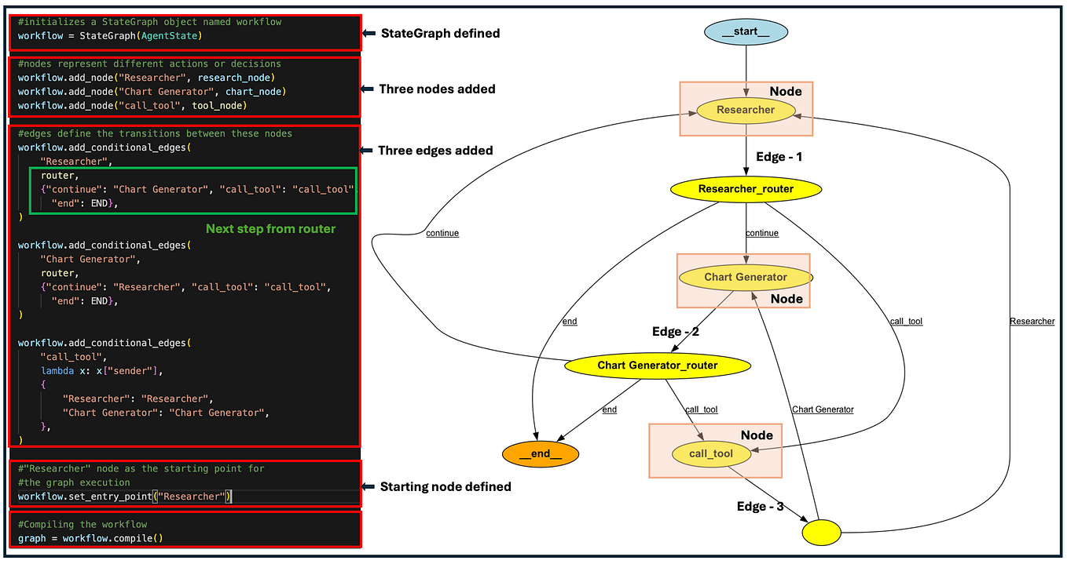
From LangChain to LangGraph: Evolution of Agent Frameworks
An example of a chart produced automatically by LangGraph.
If you want, you can go into details when creating a chart for your assignment, but the simple ones shown before are enough. You can use shapes, colors, arrows and text to show the differences between individual boxes.
Source: unknown deleted article from Medium

Slide 14
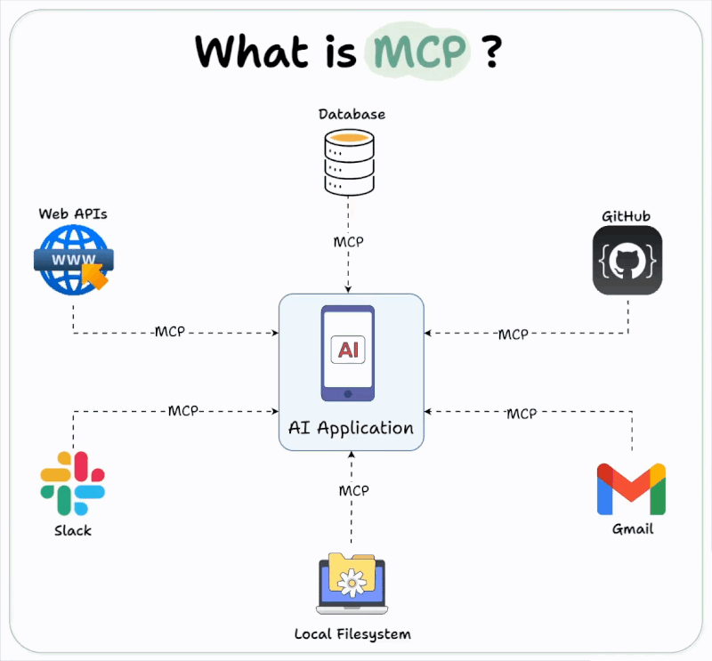
MCP Servers
Model Context Protocol (MCP) is a standardized framework for communication between different components of agentic AI, developed in November 2024 by Anthropic.
Key Features:
Universal: Eliminates custom integration needs.
Real-Time Data Access: Enhances AI accuracy with up-to-date information.
Efficient Integration: Minimal setup for scalability and quick deployment.
Wide Application: Supports diverse use cases across industries (e.g., enterprise, healthcare, customer support).
Source: https://medium.com/@max.petrusenko/the-ultimate-claude-
hack-how-to-load-your-entire-github-repo-in-one-shot-e09c3be74f75

Slide 15
Evaluating Agentic AI Systems
Agentic AI systems are designed to perform tasks autonomously, requiring robust evaluation methods to ensure reliability and effectiveness.
End-to-End Evaluation: Testing the AI system as a whole by executing complete workflows.
Ensures the system performs effectively in real-world scenarios.
Captures interactions and dependencies between components; assesses overall system performance.
May overlook individual component failures; limited diagnostic insight.
Component Evaluation: Testing individual components of an AI system separately.
Identifies the strengths and weaknesses of each component.
Provides detailed diagnostic information; facilitates targeted improvements.
May miss issues arising from component interactions when integrated.

Slide 16
Evaluating Agentic AI Systems
Test-Driven Development (TDD): A software development approach where tests are written before the code itself.
Encourages modular development, making components easier to test.
Helps in setting clear, measurable objectives for AI behavior.
Performance Metrics:
Accuracy: Correctness of the AI’s outputs.
Robustness: Ability to handle diverse inputs and unforeseen scenarios.
Scalability: Performance with increasing data and task complexity.
Interpretability: Understanding and transparency of the AI’s decisions.
Continuous Monitoring:
Implement systems for real-time performance tracking.
Quickly identify and address deviations from expected behavior.
Scenario-Based Testing:
Create realistic scenarios to test AI behavior under different conditions.
Ensure adaptability and resilience in varied environments.

Slide 17
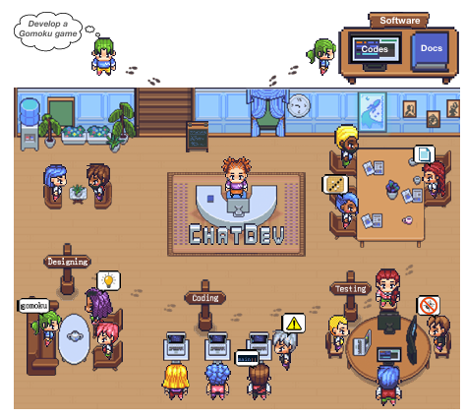
Working with larger groups of agents
Libraries such as CrewAI are created to make it easier to work with larger numbers of agents.
Imagine a full AI software development team: 2307.07924
Assign roles such as junior and senior coders, code reviewers, team leads, managers, QA testers and more
Make them interact and develop things for you.

Slide 18
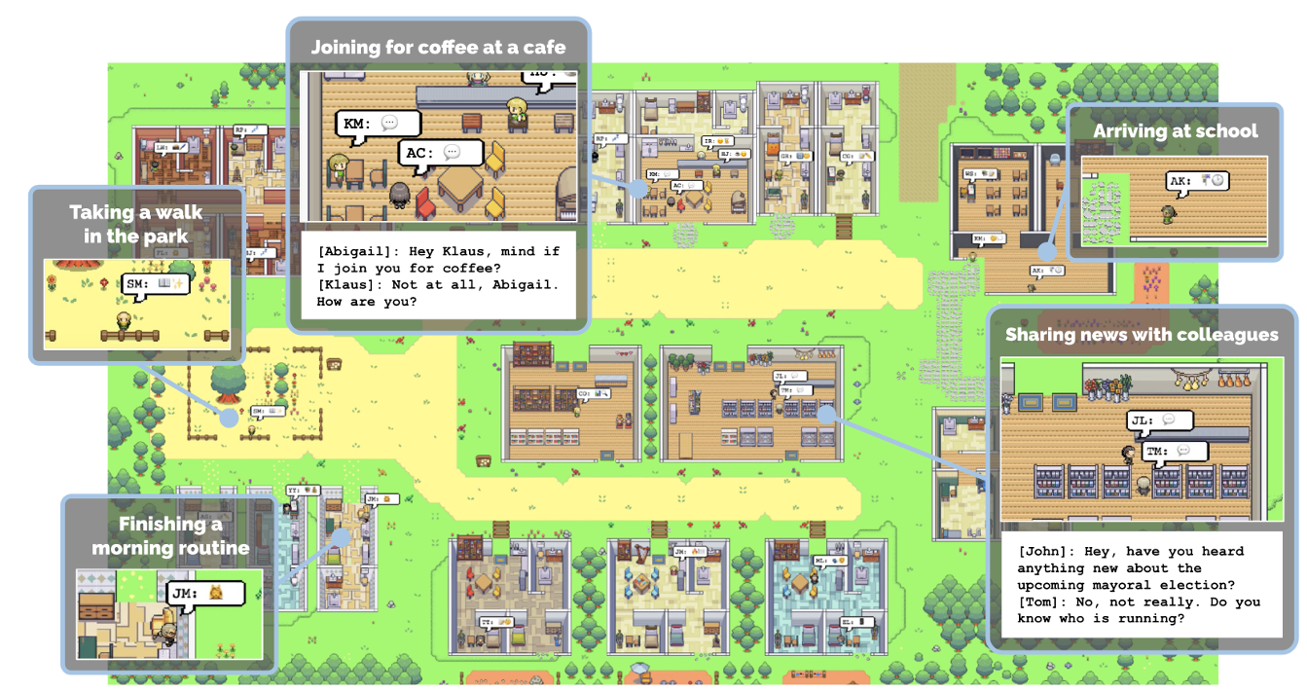
Working with larger groups of agents
Or model the behaviour of people in real world: arxiv.org/pdf/2304.03442
Let them wake up, cook, go to work, do art, etc… and see what happens!

Slide 19
Collaborative Research Swarm
AI swarms refer to a large collective of AI agents working together to solve complex problems inspired by natural systems like ant colonies or bee swarms. AI swarms leverage the power of collective intelligence, mirroring nature's problem-solving strategies.
Think about collective intelligence: Does there exist a single human in the world who can create a cellphone from scratch?
Benefits of Creating a Huge Number of Agents:
Scale: Large numbers of agents can handle vast and complex problems by distributing the tasks.
Robustness: Redundancy and diversity within the swarm increase fault tolerance. The system can continue functioning even if individual agents fail.
Parallelism: Many agents can work simultaneously, speeding up problem-solving and improving efficiency.
Adaptability: Swarm intelligence allows systems to dynamically adapt to changing environments and requirements by reconfiguring agent roles and priorities.
Diversity of Solutions: The collaborative nature of swarms promotes a variety of strategies and solutions, increasing the chance of innovative outcomes.
Does it really work?
I don’t know. It is certainly not mainstream to work with 1000s of “agents”, but people are trying it out.

Slide 20
Assignment 3
Build an agentic system to write a short report about one of the chosen topics you learned about in this course (CI/CD, MLops, APIs, Gradio, or anything of your choice).
Report (15 points total):
Your software should be able to produce a report with 1000 words (+- 50 words). (5 points)
The report should be factually correct and have a clear structure (introduction, main text, conclusion or similar), marked with clear titles. (5 points)
The topic of the report should be related to the course. (5 points)
Agentic system (65 points total):
The prompts should be clear and follow the best prompting practices (15 points)
The model can use either a simple single call to an LLM (5 points) or a complex agentic system (up to 50 points). Be creative here. You can use LangChain or LangGraph, you can create multiple agents (one for writing, one for research, fact checking etc…). Find some examples and ideas online. Let the agent use tools. For example web search or RAG to find information on the given topic. You can use tools to check for the length of the report (remember that LLMs are not good at counting, but a python script can be very efficient).
System diagram (10 points total):
Draw a diagram of your agentic workflow. (Note that some of the libraries like LangGraph can do this automatically. It doesnt matter how you do it, as long as you create some form of a diagram that shows how your system works)
User interface (10 points total):
Create an interface in Gradio and deploy to GCP to be part of your OpenAPI project. Be creative. Choose your own things you want to display and control. For example you can let the user input the topic or control the temperature of the models. You can have the app display the report on screen or save it to a txt file (or both). (10 points)
(Optional) If you are feeling very creative, you can add a human in the loop component, where a human can edit the “working version” of the document before submitting it for future review to the agent. You can also let the user input additional prompts to modify how the agent behaves on the go (bonus 10 points)
Since some of you might create interactive apps, please submit the code; the AI generated report together (the report can be a simple .txt file or whatever similar); and a URL to your OpenAPI project on GCP. In addition, please submit an image file showing the diagram of your agentic system. If your app allows to use different settings, please also include instructions (it can be in the app or in a readme.md or similar file with the settings of your app that you used to produce the graded report). If there are any other comments/remarks/explanations you would like to make to accompany your submission, also put them into the readme file (optional).

